Slide 1
A study on linguistics data to identify author gender and gender bias by the responders
Chaitree Sham Baradkar
2021HCS7248

Slide 2
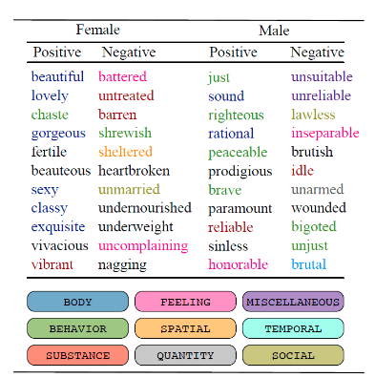
Introduction
Language serves as a tool for constructing social categories like gender
Hence, social problems like gender bias frequently manifest in language.
Linguistic data can be used to identify gender bias (stereotypes used while addressing gender or checking validity of myths about gender bias
Text is everywhere over the internet
Hence, using internet posts on various genre we are able to identify if authors tend to use certain type of words more or talk about certain issues more
We also study the responders comments to authors and see if responders react differently to the posts written by male and female
Also, if there is any pattern if the responder is male or female
Source [1]
Sources: [1] https://theswaddle.com/study-of-3-5-million-books-highlights-gender-bias-in-literature/]

Slide 3
Motivation
It is important to know how male or female describe themselves or their work
It helps in targeting certain population or identifying gaps in communication while creating impact, for example, women might not want to apply for certain jobs if job description uses lot of adjectives describing men
If gender can be identified from the post text, it poses threats to anonymity and becomes important to see if it increases bias towards certain genders
If it is important to preserve anonymity of poster, knowledge regarding gender bias will be important to modify posts accordingly
We also need to see how responders perceive contents from the authors of different genders and if they exhibit any gender bias
It might also differ how particular gender responds to same gender or the opposite gender
Machine Learning algorithms are identifying patterns from such dataset and replicating the same. For example, tools like conversation agents could learn from such datasets that might reflect this gender bias. This needs to be avoided

Slide 4
Related Work
Authors in [1] tried to identify author gender for short length, multi-genre, content-free text using Machine Learning algorithms and show that function words (Number of auxiliary-verbs, Number of conjunction words), word-based features (represent the way an author organizes the layout of a message like vocabulary richness, number of short words) and structural features (Total number of paragraphs, average number of sentences per paragraph) are significant gender discriminators. Hence, showed that male and female authors use different style of writing
[2] talks about identifying gender on web forums dataset to understand their needs and provide care. They present a gender detection model using sentiment analysis and machine learning including deep learning and shows that deep learning generates better accuracy especially for identifying female authors
Work in [3] demonstrates the possibility to accurately identify a user's gender, age, etc from language indicators in publicly posted remarks made about them. They also show that directed communication is even more predictive of a user’s profile than the user’s own.
Main paper that is referred for this project is [4] where author is presenting a multi-genre corpus of more than 25M comments from five socially and topically diverse sources tagged for the gender of the addressee
They present some pilot studies regarding gender identification and descriptive analysis of significant words used by males and females towards authors of specific gender
We tried to replicate these pilot studies and also tried to find if the responses are predictive of gender of authors

Slide 5

Resources and Tools
Dataset - RtGender
Language : English
Size :
Annotation for post Post ID - Poster Name - Poster Gender - Post text
Annotation for responses Poster ID - Post ID - Poster Gender - Responder ID or Responder Name - Response Text - Responder Gender
Ted talk posts are not available. Therefore, skipped the results on Ted Talks data
Responder gender is only given in reddit responses and fitocracy responses dataset
Tools -
Programming Languages and major libraries used - R : tidylo, dpylr , Python : nltk, matplotlib, pandas
Weighted log ratios were used in R to find out significant words for a particular category
NLTK and regex to preprocess data
countvectorizer and tf-idf vectoriser to create features for ML model
Simple Logistic Regression for classification
Running LMER to see fixed and random effect of datasets was not successful hence used simple ratio based analysis to replicate sum results
Pipeline -
Checking model performance using accuracy
Preprocess data
Feature extraction (countvectorizer and tf-idf)
Classifica-
tion
Note: they did not mention preprocessing methods on text. Hence, used different methods. Methods differed for each dataset.

Slide 6
Results

Slide 7
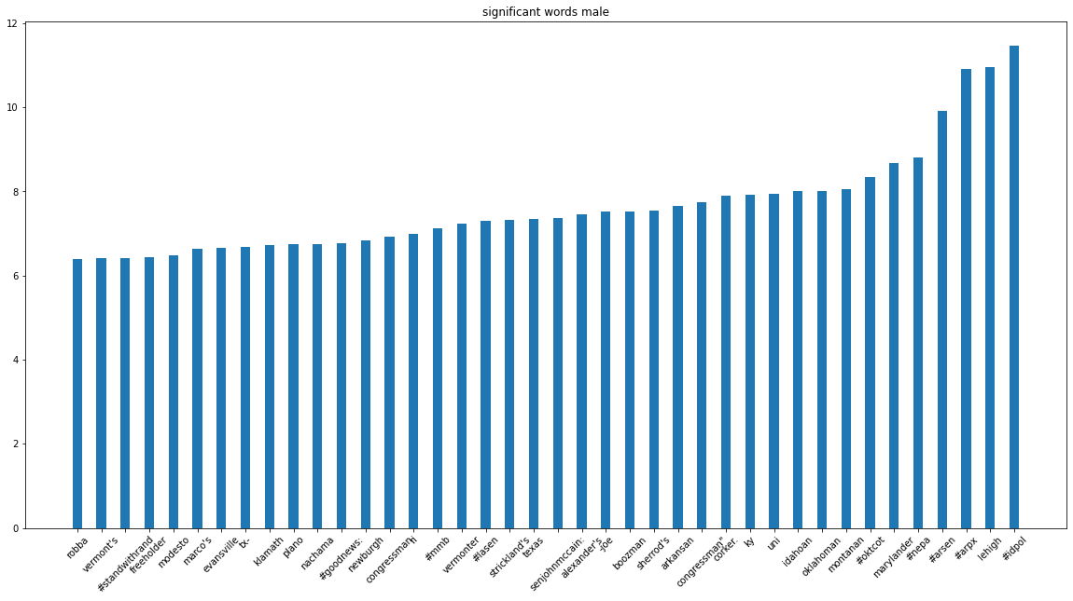
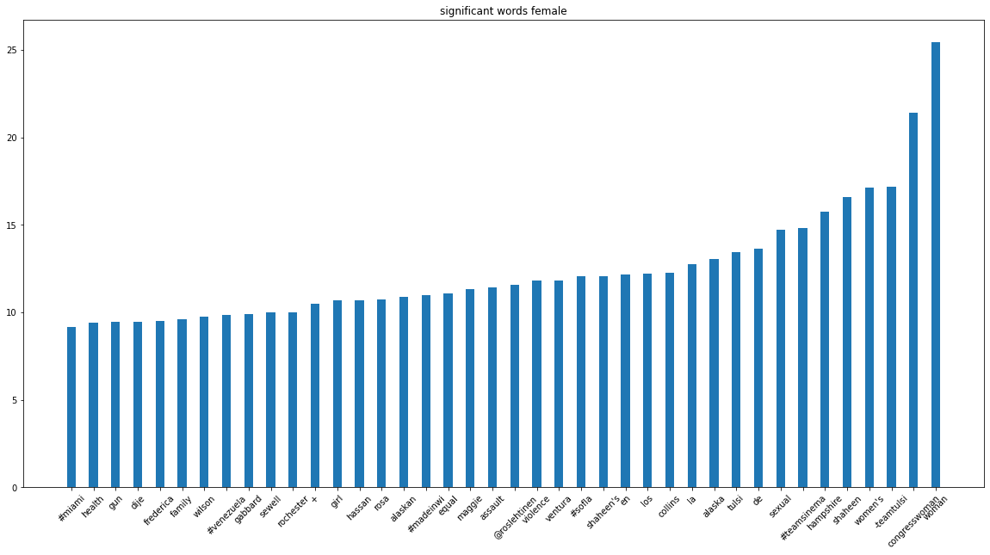
Significant words used by specific gender while writing posts
Facebook (politicians) posts
No significant patterns found
Women are talking more about assault, sexual, equality , family, health, etc.

Slide 8
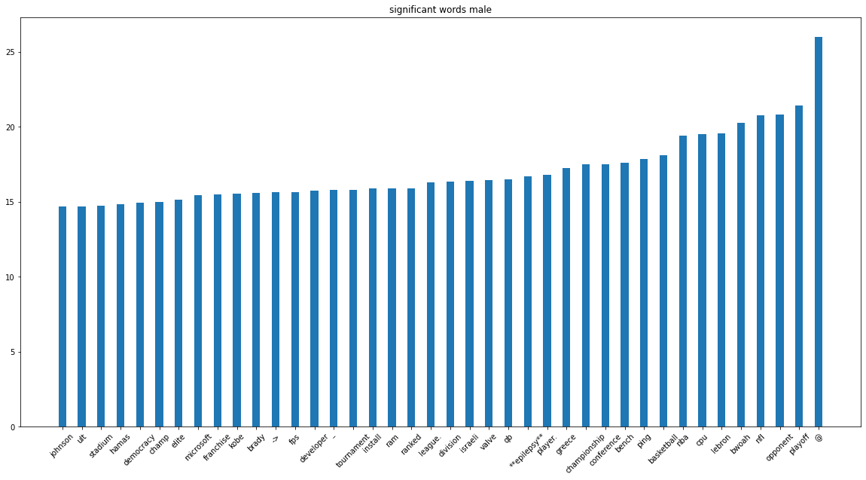
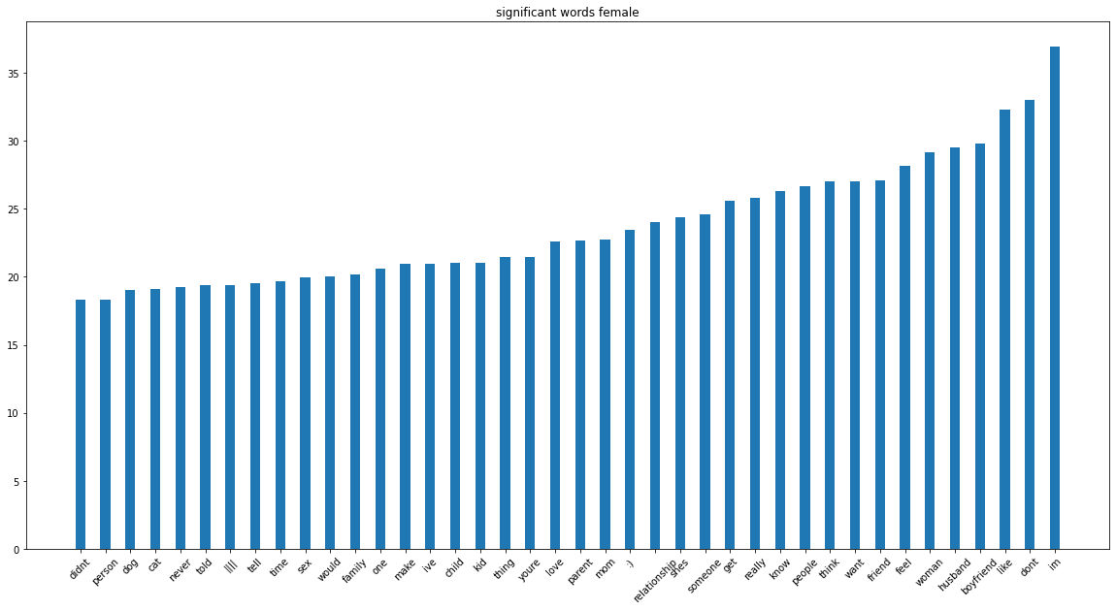
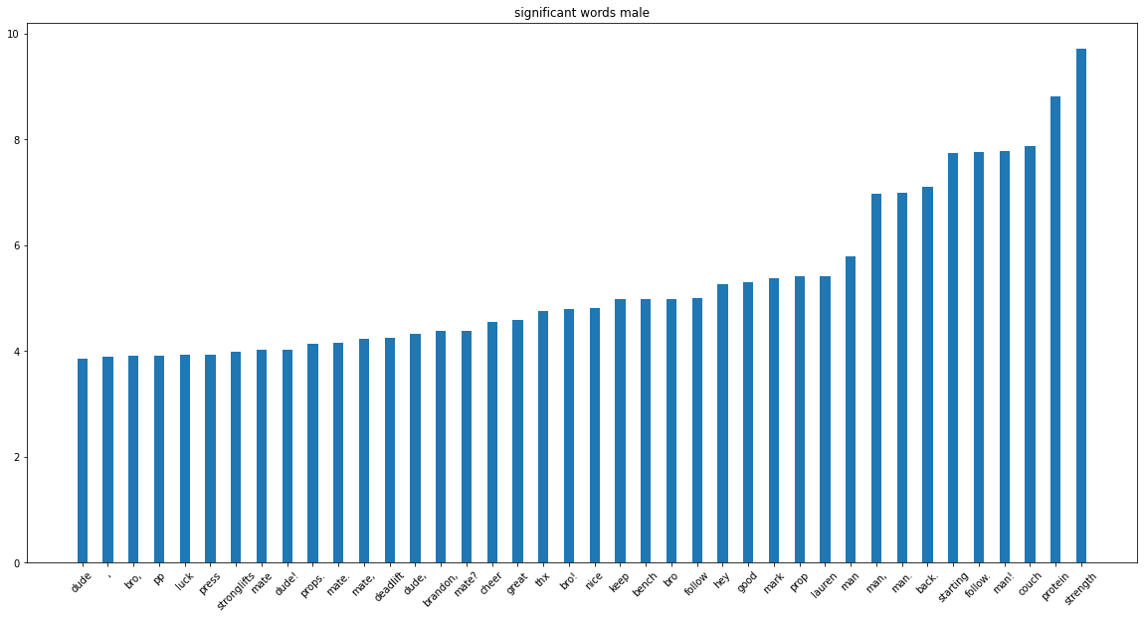
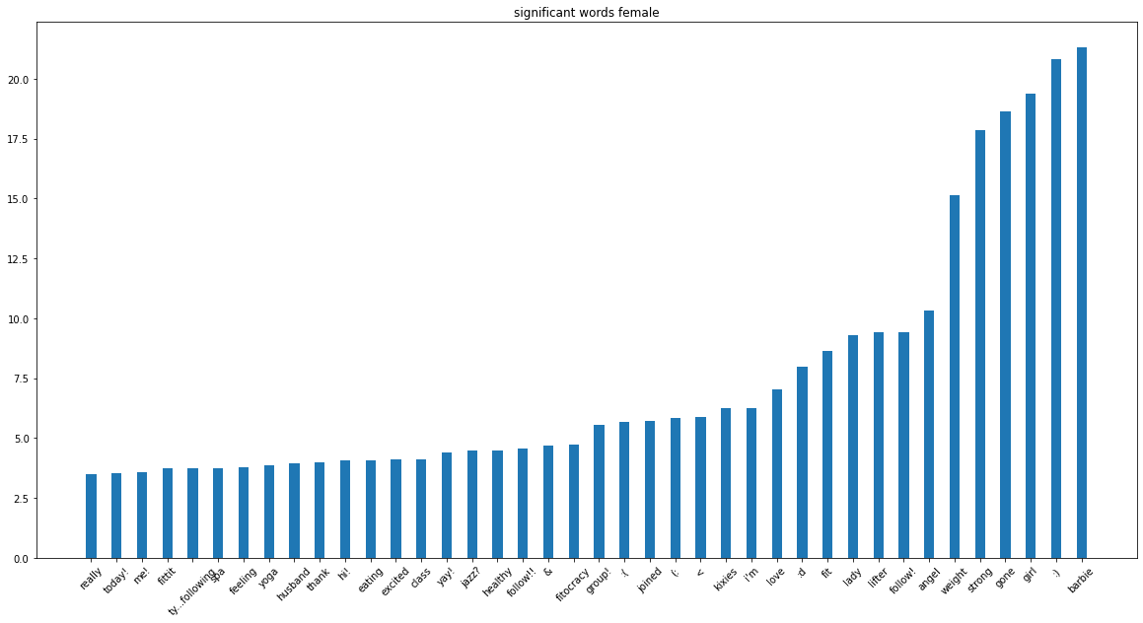
Reddit posts
Men are talking about sports like basketball, conference, championship, league, playoff, tournament and current events and companies
Women again are talking more about family, child, parent, mom, husband, boyfriend, etc, and sex, friend, love, etc.
Fitocracy Fitness Posts
Men significantly use different ways to address themselves and use less emojis
Women are talking in general about husband, weights, following posts, thanking people, etc. and significantly use emojis

Slide 9
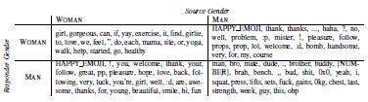
Significant words used by responders
Fitocracy Fitness responses
Findings mentioned in the paper
The word preferences of responders show a
substantial gender-correlated signal in this data.
Men commenting on posts by men use many close terms of informal address (“bro,” “dude,” “brother,” “buddy”) and likewise for women commenting on posts by women (“girl,” “girlie,” “mama”).
Cross-gender comments, however, are more emotive, with prominent use of emoticons, emoji, and exclamation points, as well as more playful and interactive language (talk of ”following” each other and use of second person pronouns) and discussion of the addressee’s appearance, e.g., “beautiful” (M!W) and “handsome”.
Mentioned by Paper
Author / Responder | Woman | Man
Woman | Etc-leave, exercise, drop, start, around, tap, fitocracy, wtf-welcome, help, consistent, training, supportive, finding, guides on, community, trask, question, need, place, workout, stairs, screen, earning, icon, welcome, hello, great, | Etc-leave, exercise, drop, start, help, fitocracy, group, name, message, guides, community profile, consistent, supportive, training, ya, finding, ask, trck, web, glad, getting, iphone, way, welcome, need, great, place, know
Man | thanks , following, good, :), like, back, see, best, people, better, get, follower, posting, noticed, grouped, yet, facebook, welcome, statues, probably, :-), ={d, i’ve, hi, likely, twitter, back , luck, hope, work, prop | Man, thanks, get, like, I’m, sir!, good, I’ve, see, back, got, around, probably, yeah, work, time, it, bro, best, people, week, bro, best, weight, mate, squat , brother, ={d, tips
Obtained by weighted log odds method on dataset
Replicated - 1. Men commenting on posts by men use many close terms of informal address (“bro,” “dude,” “brother,” “buddy”). It was not seen in woman commenting on women's’ posts.
2. Cross gender comments, only in case of Man responding to woman’s post was more emotive, use of lot of emoticons, emojis.
3. In both cross gender comments, use of more playful and interactive language as talks of following each other, etc, is seen

Slide 10
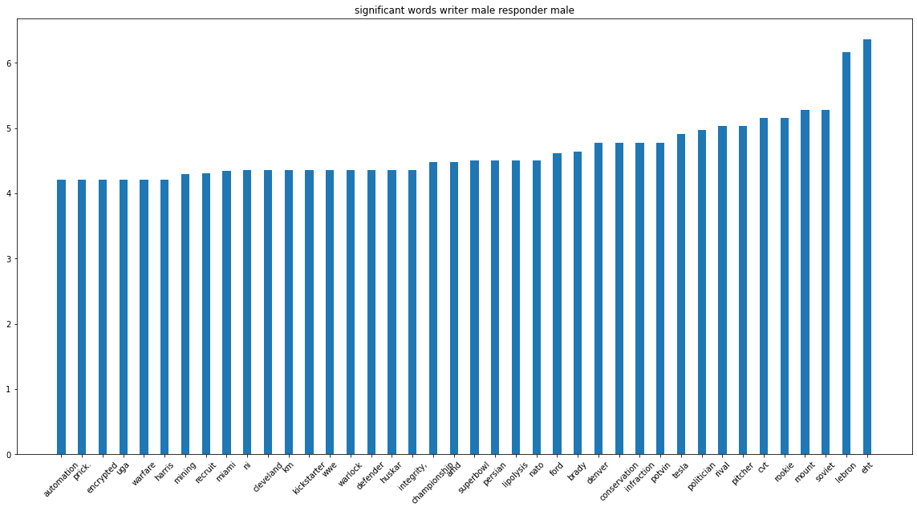
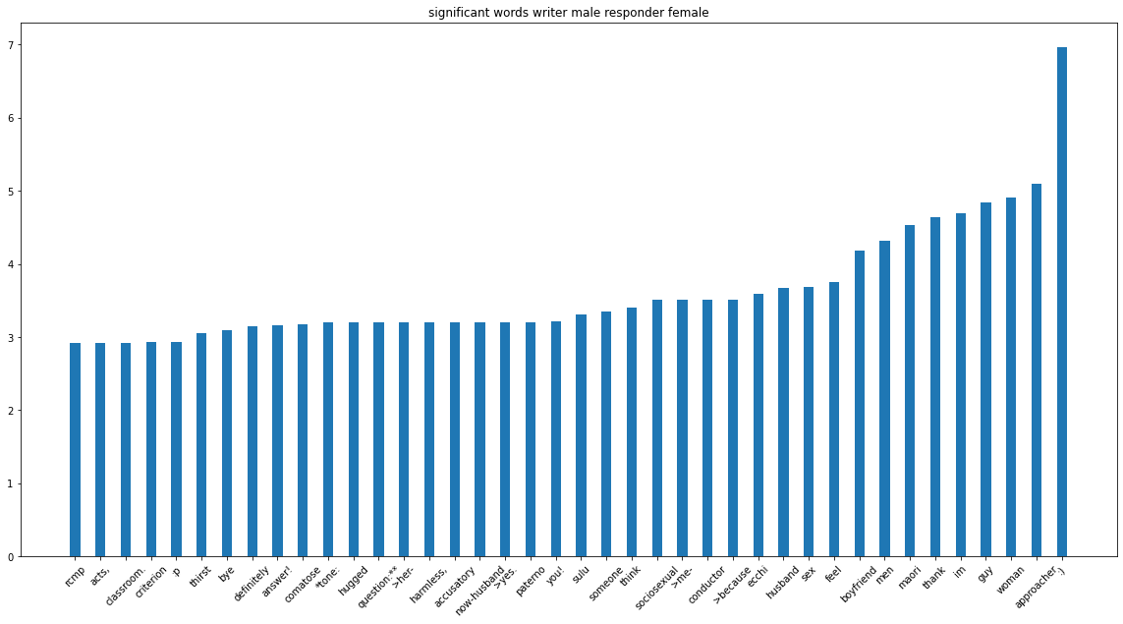
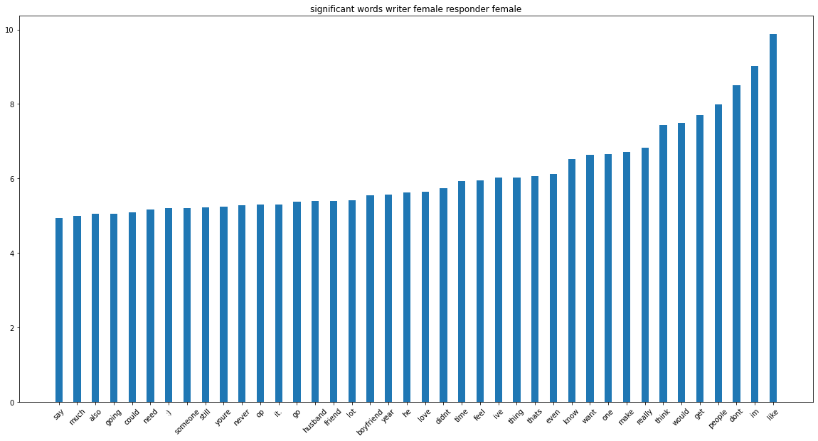
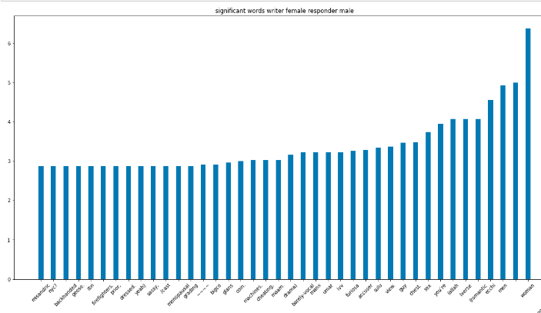
Reddit Posts responses
M-> M mix topics like politics, politicians, sports, championship, news, etc
M-W more generic, emoji :) is used often, words like woman, boyfriend, husband, feel, sex, approacher, someone, think, etc are used
W->W like, people, im, get, think, make, want, know, thing, feel, time, love, he, year, Boyfriend, friend, husband, etc
W->M like women, men, romantic, sex, chest, guy, view, accuser, furiosa, drama, cheating, maam, machines, coin, menopausal, saasy, prior, etc

Slide 11
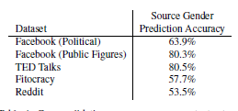
Accuracy of identifying gender from post texts
Accuracy of identifying gender from response texts
Dataset | Source gender prediction accuracy (using countvectorizer) | Source gender prediction accuracy (using tf-idf)
Facebook (politicians) | Test data - 81.08% Complete data - 83.06% | Test data - 81.10% Complete data - 82.55%
Facebook (public figures) | Test data - 81.56% Complete data - 85.30% | Test data - 81.82% Complete data - 85.17%
Fitocracy | Test data - 62.91% Complete data - 64.63% | Test data - 63.43% Complete data - 65.87%
Reddit | Test data - 79.87% Complete data - 80.28% | Test data - 79.82% Complete data - 80.13%
Mentioned in the paper
Note: Ted talk posts text was not available, hence did not calculate accuracy on that
Evaluated using pipeline mentioned
Dataset | Source gender prediction accuracy from post texts (using countvectorizer) | Source gender prediction accuracy from response texts (using countvectorizer) | Source gender prediction accuracy from response texts and responder gender (using countvectorizer)
Fitocracy | Test data - 62.91% Complete data - 64.63% | Test data - 58.98% Complete data - 60.8% | Test data - 60.75% Complete data - 62.76%
Reddit | Test data - 79.87% Complete data - 80.28% | Test data - 78.99% Complete data - 79.11% | Test data - 77.70% Complete data - 77.87%

Slide 12
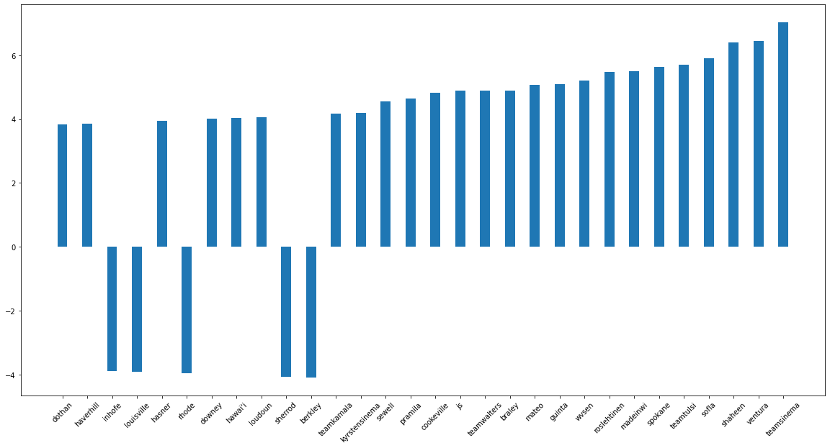
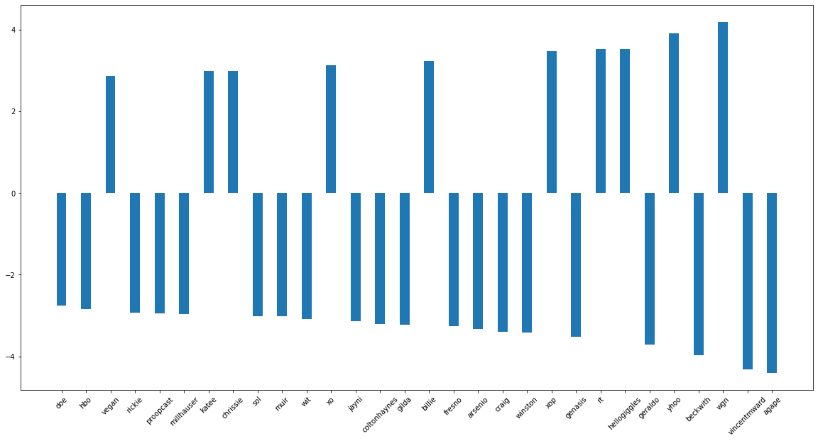
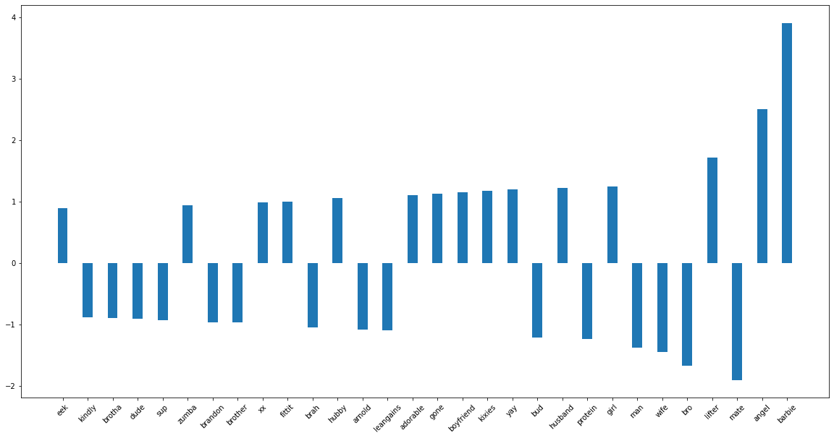
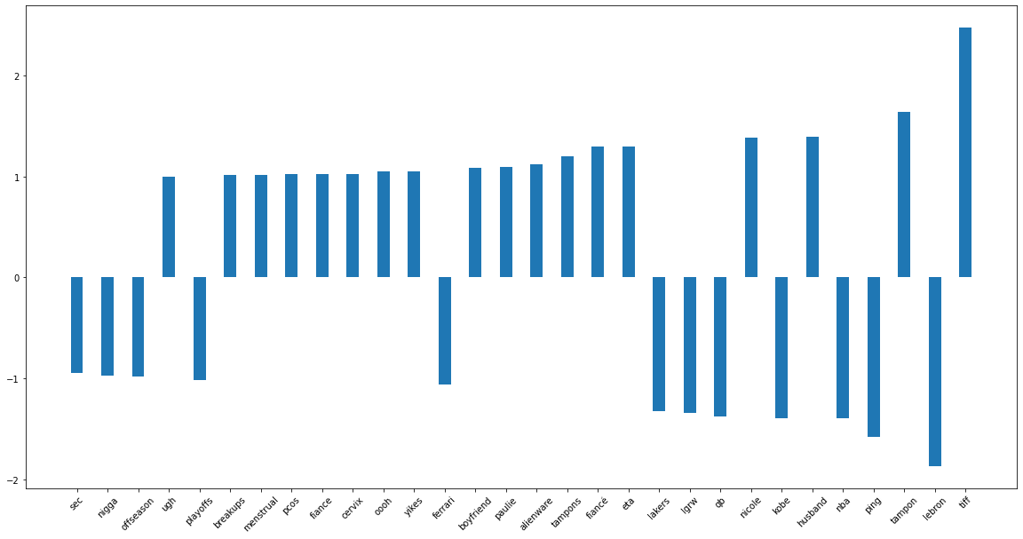
Feature importance for author gender classifiers using posts text countvectorizer
Facebook politicians post
Facebook public figures post
Fitness posts
Reddit Posts

Slide 13
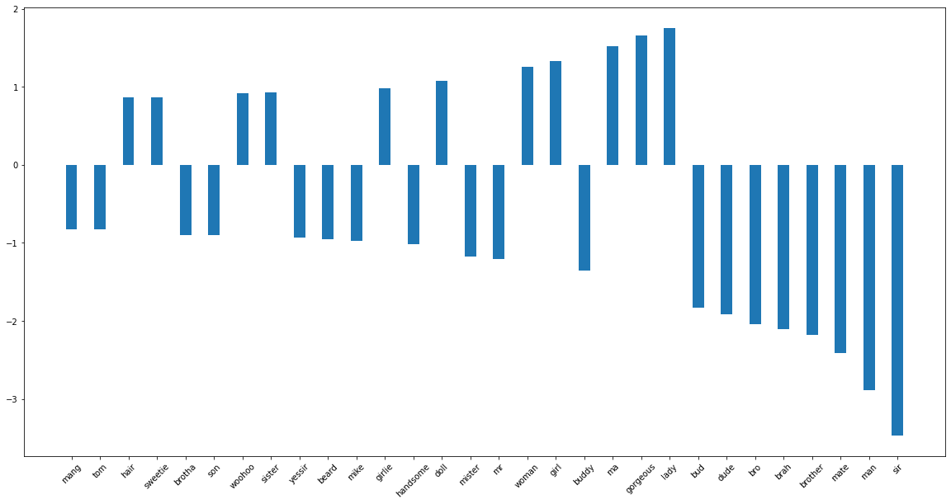
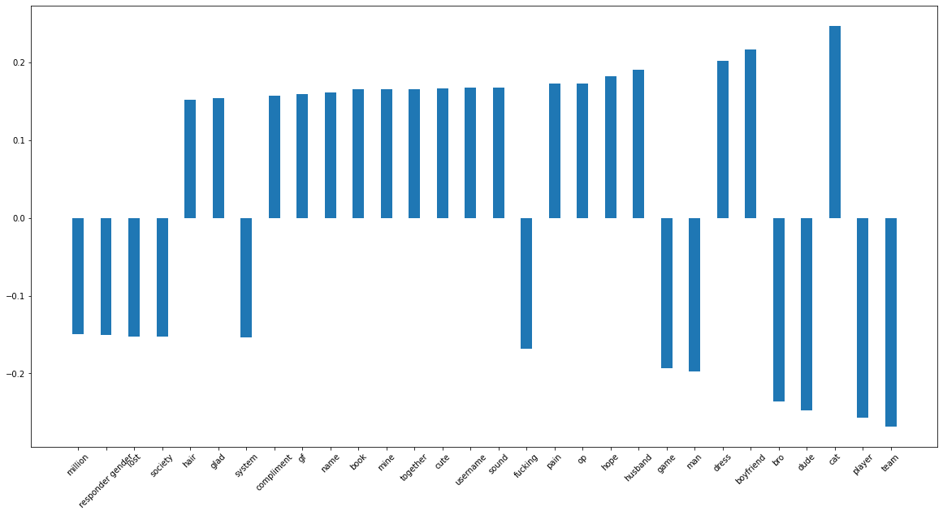
Feature importance for author gender classifiers using response text countvectorizer
Fitness responses
Reddit Responses

Slide 14
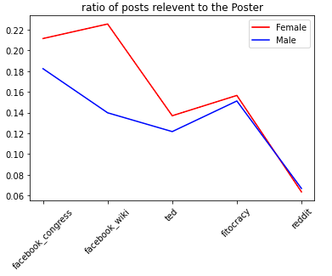
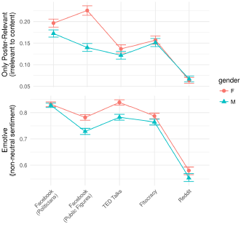
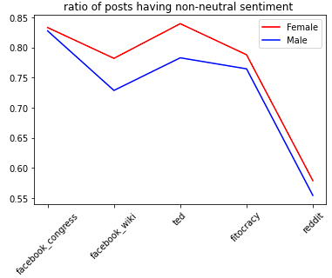
Relevance and Sentiment Annotations
Findings in the paper - In general responses to women were more likely to be about the source poster or speaker as an individual and were more emotive (having non-neutral sentiment) than responses to men
We were able to replicate the findings in the paper. Note that paper has used model for fixed and random effects. However, we have done it using simple ratio of posts method.

Slide 15
Conclusion and Discussion

Slide 16
We were able to replicate some of the results from the paper like how significant words used by responders vary according to responder gender and author gender
We also tried to look at how major topics discussed differs according to author gender using significant words used in post text
We were also able to replicate accuracy results for author gender identification using post texts. For two datasets, fitocracy and reddit we got better accuracy than baseline
Feature importance of these classifier show relevant features getting used for classifiers
We tried to compare accuracy of author gender identification using post texts and using responder texts and responder gender. The two accuracies were comparable and responder text was able to predict author gender comparably but not better that posts text itself unlike mentioned in [3]
Adding responder gender information did not have any improvement while predicting author gender. Some more data analysis will be required to see if responder texts itself was significant enough to talk about their gender
Hence, identifying author gender is possible using post texts as well as responders texts
The way of responses to author posts may be different according to author as well as responders gender
This simple analysis provided few such important insights that need to be further strengthened by more rigorous data analysis methods like Deep Learning applying on large linguistics data

Slide 17
References:
[1] Cheng, Na & Chandramouli, Rajarathnam & Subbalakshmi, K.. (2011). Author gender identification from text. Digital Investigation. 8. 78-88. 10.1016/j.diin.2011.04.002.
[2] Park, Sunghee & Woo, Jiyoung. (2019). Gender Classification Using Sentiment Analysis and Deep Learning in a Health Web Forum. Applied Sciences. 9. 1249. 10.3390/app9061249.
[3] Jurgens, David & Tsvetkov, Yulia & Jurafsky, Dan. (2017). Writer Profiling Without the Writer’s Text. 537-558. 10.1007/978-3-319-67256-4_43.
[4] Voigt, R., Jurgens, D., Prabhakaran, V., Jurafsky, D., & Tsvetkov, Y. (2018). RtGender: A Corpus for Studying Differential Responses to Gender. LREC.

Slide 18
Thank you!

